Slide 1
Correlation Analysis

Slide 2
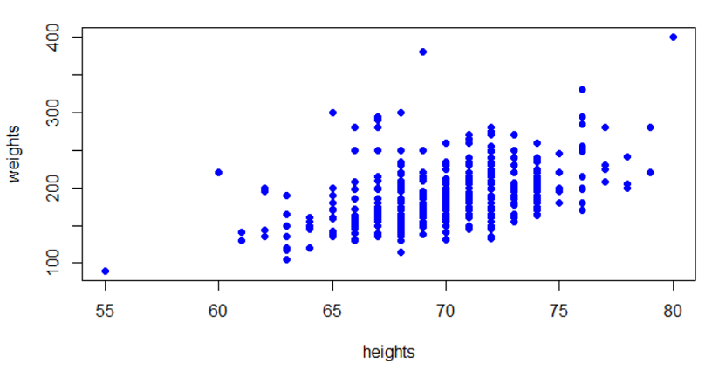

Correlation analysis is a statistical method used to measure the strength of the linear relationship between two variables.
Correlations are very useful for building predictive models.
Scatterplots are a great way to check for correlation between continuous variables:
What is correlation analysis?
Notes:
Correlation analysis in research is a factual strategy used to quantify the strength of the direct correlation between two factors and figure out their affiliation. It ascertains the degree of progress in one variable because of the change in the other. A high correlation focuses on a solid correlation between the two factors, while a low correlation implies that the factors are pitifully related.
With regard to statistical surveying, specialists use this strategy to break down quantitative information gathered through research strategies like reviews and live surveys. They attempt to recognize the correlation, designs, huge associations, and patterns between two factors or datasets.
There is a positive correlation between two variables when an increment in one variable prompts an increment in the other. Then again, a negative correlation implies that when one variable expands, different declines as well as the other way around.
Real-life examples of correlation analysis
Here are the 3 best examples of correlation in life;
Example 1: Air conditioning bills vs. the weather
When it comes to weather, it’s simple to quantify negative correlation because a rise (or drop) in outside temperature influences the use of air conditioners.
Example 2: Increase in demand vs. price
In the business sector, one example of a positive connection is the demand for and cost of a product. With the demand for a product the price also increases; when demand declines, so does the price.
Example 3: Health Improvement vs. Medical Dose Reduction
Correlational studies are commonly utilized in clinical trials to understand better how a newly developed medicine affects patients. If the patient’s health improves as a result of taking the medication regularly, there is a positive correlation.
However, if health does not improve or deteriorate, there is no correlation between the two variables, i.e., health and medicine.
benefits of Correlation Analysis?
The benefits of correlation analysis are
Notice correlations: A correlation assists with distinguishing the nonappearance or presence of a correlation between two factors. It will, in general, be more applicable to day-to-day existence.
A decent beginning stage for research: It ends up being a decent beginning stage when an analyst begins researching correlations interestingly.
Utilized for additional analysis: Researchers can distinguish the course and strength of the correlation between two factors and thin the discoveries down in later analysis.
Basic measurements: Research discoveries are easy to group. The discoveries can go from -1.00 to +1.00. There can be just three expected wide results of the analysis.

Slide 3
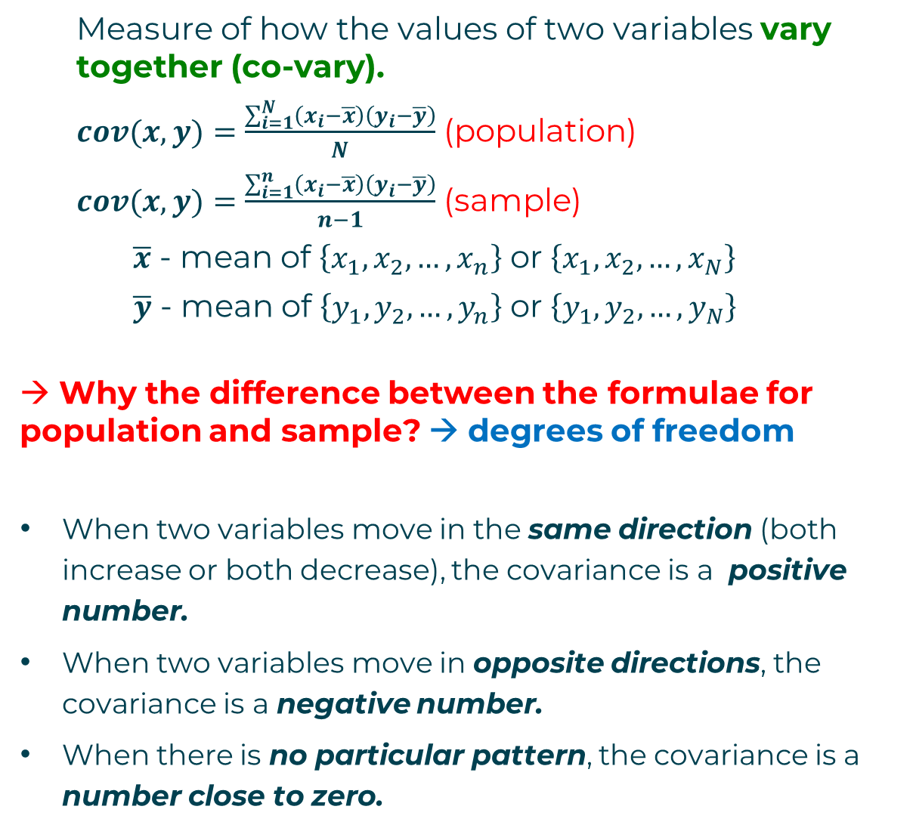
Measure of how the values of two variables vary together (co-vary).
$cov(x,y)=\frac{\sum_{i=1}^{N}{\left(x_{i}−\overline{x}\right)\left(y_{i}−\overline{y}\right)}}{N}$ (population)
$cov(x,y)=\frac{\sum_{i=1}^{n}{\left(x_{i}−\overline{x}\right)\left(y_{i}−\overline{y}\right)}}{n−1}$ (sample)
$\overline{x}$ - mean of $\left\{x_{1},x_{2},…,x_{n}\right\}$ or $\left\{x_{1},x_{2},…,x_{N}\right\}$
$\overline{y}$ - mean of $\left\{y_{1},y_{2},…,y_{n}\right\}$ or $\left\{y_{1},y_{2},…,y_{N}\right\}$
→ Why the difference between the formulae for population and sample? → degrees of freedom
When two variables move in the same direction (both increase or both decrease), the covariance is a positive number.
When two variables move in opposite directions, the covariance is a negative number.
When there is no particular pattern, the covariance is a number close to zero.
coVariance
Notes:
Covariance and correlation are fundamental concepts in statistics and mathematics that measure the relationship between two random variables. They are essential tools for understanding how variables change together and are widely used in various fields, including finance, economics, and science.
Covariance:
It is the relationship between a pair of random variables where change in one variable causes change in another variable.
It can take any value between – infinity to +infinity, where the negative value represents the negative relationship whereas a positive value represents the positive relationship.
It is used for the linear relationship between variables.
It gives the direction of relationship between variables.

Slide 4
Covariance is difficult to interpret and compare.
→ It is measured in units[x]*units[y]
We cannot say what is a high or a low value in the general case.
We cannot compare the covariances of two pairs of variables.
coVariance
Height vs weight
Apples and pears?
Salary vs age
Notes:
If variance is the measure of how dispersed a set of observations of a single variable are, covariance is the extent to which the variance in one variable depends on another variable. In effect, covariance is a measure of the relationship between two variables. The higher the covariance, the stronger the relationship.
Covariances can be positive (both variables move in the same direction), negative (both variables move in different directions), or in the case of no relationship, zero.

Slide 5
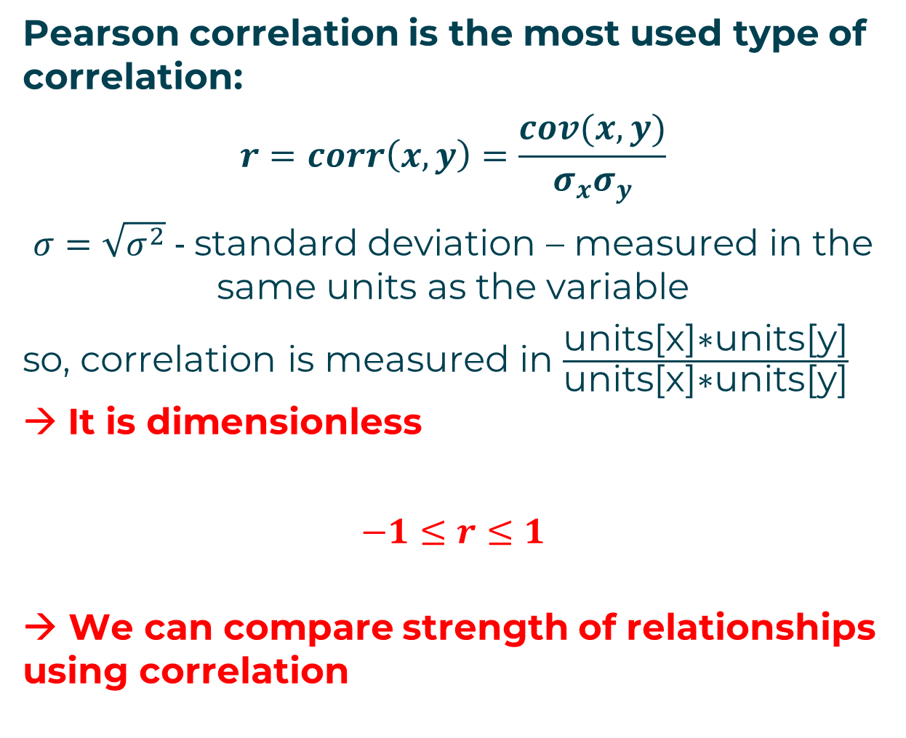
Pearson correlation is the most used type of correlation:
$$r=corr\left(x,y\right)=\frac{cov(x,y)}{σ_{x}σ_{y}}$$
$σ=\sqrt{σ^{2}}$ - standard deviation – measured in the same units as the variable
so, correlation is measured in $\frac{\text{units}\text{[}\text{x}\text{]∗}\text{units}\text{[}\text{y}\text{]}}{\text{units}\text{[}\text{x}\text{]∗}\text{units}\text{[}\text{y}\text{]}}$ → It is dimensionless
$$−1≤r≤1$$
→ We can compare strength of relationships using correlation
Pearson correlation
Notes:
Similarity scores are based on comparing one data object with another, attribute by attribute, usually summing the squares of the differences in magnitude for each attribute, and using the calculation to compute a final outcome, known as the correlation score. One of the most popular correlation methods is Pearson's correlation, which produces a score that can vary from − 1 to + 1. Two objects with a high score (near + 1) are highly similar.¹⁸ Two uncorrelated objects would have a Pearson score near zero. Two objects that correlated inversely (ie, one falling when the other rises) would have a Pearson score near − 1 (See Glossary items, Correlation distance, Normalized compression distance).
The Pearson correlation for two objects, with paired attributes, sums the product of their differences from their object means, and divides the sum by the product of the squared differences from the object
What is a good Pearson R correlation?
If we wish to label the strength of the association, for absolute values of r, 0-0.19 is regarded as very weak, 0.2-0.39 as weak, 0.40-0.59 as moderate, 0.6-0.79 as strong and 0.8-1 as very strong correlation, but these are rather arbitrary limits, and the context of the results should be considered.
The name correlation suggests the relationship between two variables as their Co-relation. The correlation coefficient is the measurement of correlation. To see how the two sets of data are connected, we make use of this formula. The linear dependency between the data set is done by the Pearson Correlation coefficient. It is also known as the Pearson product-moment correlation coefficient. The value of the Pearson correlation coefficient product is between -1 to +1. When the correlation coefficient comes down to zero, then the data is said to be not related. While, if we are getting the value of +1, then the data are positively correlated and -1 has a negative correlation.

Slide 6
To apply Pearson correlation, the following assumptions must be satisfied:
Level of measurement: Each variable must be continuous. If one or both of the variables are ordinal, then Spearman correlation can be used instead.
Related pairs: Each observation should have a pair of values, i.e., each value of the first variable should have a corresponding value of the second variable.
Absence of outliers: Having outliers can skew the results of the correlation. Typically, a value is considered an outlier if it is more than 3 standard deviations away from the mean.
Linearity: Pearson correlation is only valid for linear relationships.
Pearson correlation assumptions
Notes:
Pearson's correlation is the parametric test for correlation between two continuous (scaled-interval/ratio) variables. The assumptions to apply the test are as follows: (1) normal distribution, (2) independence of observations, and (3) linear relationship. If the first assumption, that is, normalcy, is not met or if one variable is ordinal in nature, a nonparametric alternative known as Spearman's correlation or Spearman's rho can be applied. Spearman's correlation can be applied to curvilinear relationships (in ranked or ordinal data). However, the relationship in any correlation must be monotonic, that is, as the value of one variable increases or decreases, so does the value of the other variable either increase/decrease.
Measuring normality tests must be done for both the variables through the Shapiro–Wilk test, as detailed in Chapter 3. After measuring the assumption of normality, the two continuous variables should be selected for Pearson's correlation test. Spearman's correlation, the Pearson's correlation nonparametric or distribution-free alternative, should be applied if the normality assumption fails.

Slide 7
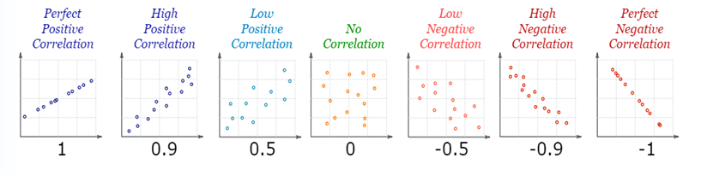
Correlation is positive when the values increase together.
Correlation is negative when one value decreases as the other increases.
A correlation is assumed to be linear (following a line).
Source: www.mathsisfun.com

Slide 8
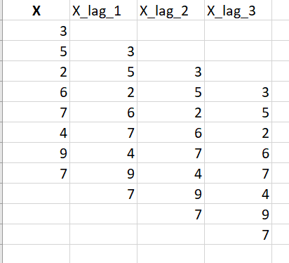
Autocorrelation is the correlation between the values of the same variable at different times. It is calculated using the Pearson correlation for lagged values of the variable.
Autocorrelation allows to find the correlation between values 1, 2, 3, … steps apart, depending on the lag.
Autocorrelation is extremely important and useful in time series analysis.
Autocorrelation (serial correlation)
Notes:
Autocorrelation is a fundamental concept in time series analysis. Autocorrelation is a statistical concept that assesses the degree of correlation between the values of variable at different time points.
Autocorrelation measures the degree of similarity between a given time series and the lagged version of that time series over successive time periods. It is similar to calculating the correlation between two different variables except in Autocorrelation we calculate the correlation between two different versions X_{t} and X_{t-k} of the same time series.
Mathematically, autocorrelation coefficient is denoted by the symbol ρ (rho) and is expressed as ρ(k), where ‘k’ represents the time lag or the number of intervals between the observations. The autocorrelation coefficient is computed using Pearson correlation.
Interpretation of Autocorrelation
A positive autocorrelation (ρ > 0) indicates a tendency for values at one time point to be positively correlated with values at a subsequent time point. A high autocorrelation at a specific lag suggests a strong linear relationship between the variable’s current values and its past values at that lag.
A negative autocorrelation (ρ < 0) suggests an inverse relationship between values at different time intervals. A low or zero autocorrelation indicates a lack of linear dependence between the variable’s current and past values at that lag.
Use of Autocorrelation
Autocorrelation detects repeating patterns and trends in time series data. Positive autocorrelation at specific lags may indicate the presence of seasonality.
Autocorrelation guides the determination of order of ARIMA and MA models by providing insights into the number of lag terms to include.
Autocorrelation helps to check whether a time series is stationary or exhibits trends and non-stationary behavior.
Sudden spikes or drops in autocorrelation at certain lags may indicate the presence of anomalies and outliers.

Slide 9
Use the following interactive site:
http://www.shodor.org/interactivate/activities/Regression/
Form different sets of points that are linearly related.
In each case, select to display the line of best fit. Note the value of the correlation coefficient r.
Demonstrate and explain:
Weak positive correlation
Strong positive correlation
No correlation
Weak negative correlation
Strong negative correlation
→ Introduce 1-2 outliers in the cases with strong correlation and demonstrate their effect on the value of the correlation coefficient and on the line of best fit.
interactive: explore correlations

Slide 10
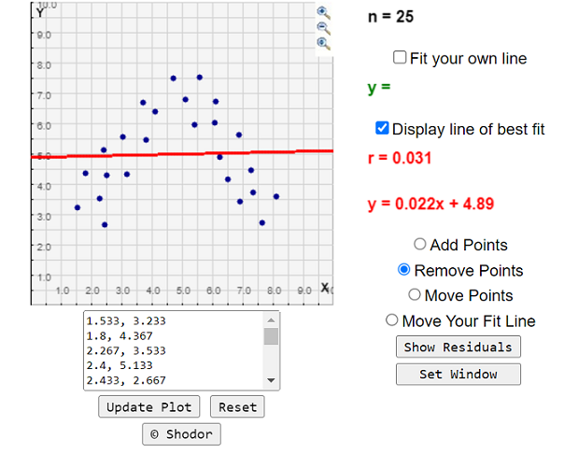
Use the following interactive site:
http://www.shodor.org/interactivate/activities/Regression/
Form a set of points that are nonlinearly related and check the value of the correlation coefficient.
There is a relationship between X and Y but it is nonlinear. Pearson correlation coefficient will not detect it – it measures only linear relationships.
interactive: explore correlations

Slide 11
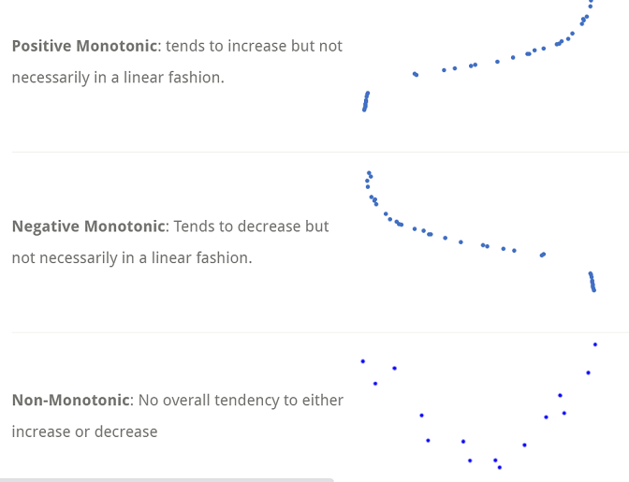
For nonlinear monotonic relationships and for ordinal data use Spearman’s correlation:
https://statisticsbyjim.com/basics/spearmans-correlation/
The alternatives
Notes:
Spearman's correlation requires your data to be continuous data that follow a monotonic relationship or ordinal data.
If there is a curvilinear but non-monotonic relationship, both Spearman’s and Pearson’s correlation will be close to zero.
When there is no tendency for two variables to change in tandem, both Spearman’s and Pearson’s will be close to zero, indicating no relationship.

Slide 12
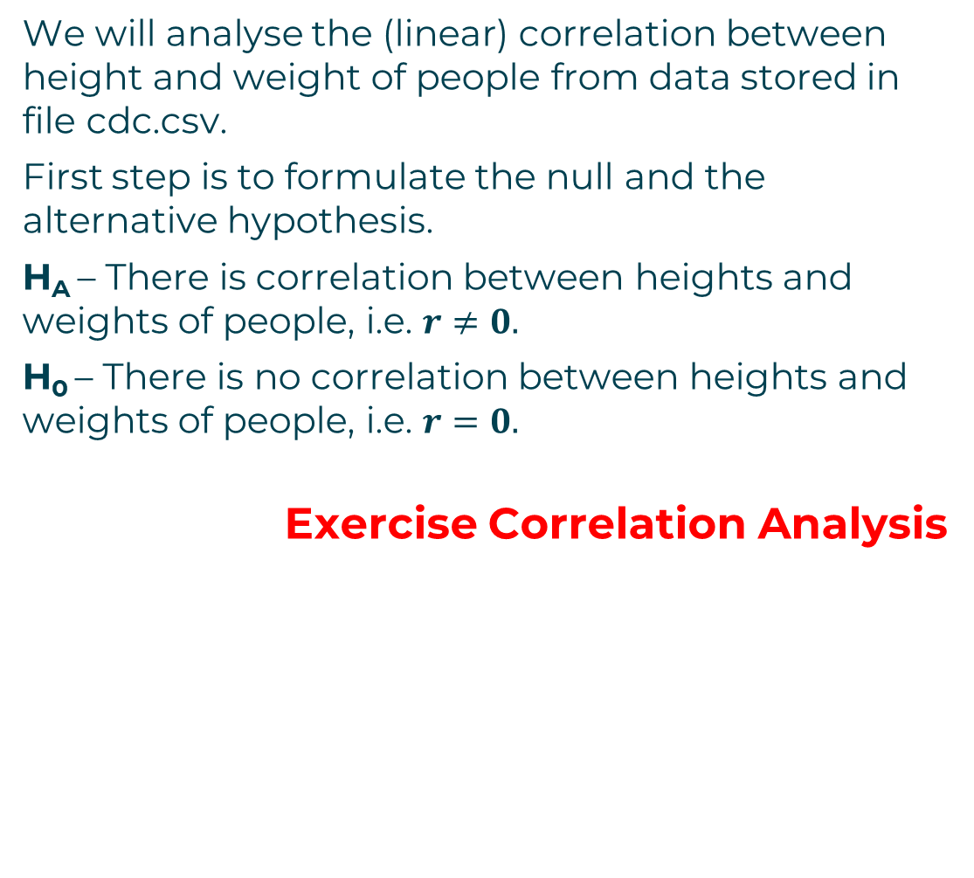
We will analyse the (linear) correlation between height and weight of people from data stored in file cdc.csv.
First step is to formulate the null and the alternative hypothesis.
H_{A} – There is correlation between heights and weights of people, i.e. $r≠0.$
H₀ – There is no correlation between heights and weights of people, i.e. $r=0.$
Exercise Correlation Analysis
Exercise: correlation analysis

Slide 13
It is a common saying that correlation is not causation.
Correlation between X and Y does not prove that X causes Y or that Y causes X.
X might cause Y
Y might cause X
X and Y may be linked by a third factor
It could be even a chance coincidence
A very interesting read with lots of examples on “Correlation does not imply causation”:
https://en.wikipedia.org/wiki/Correlation_does_not_imply_causation
correlation is not causation

